Slide 1

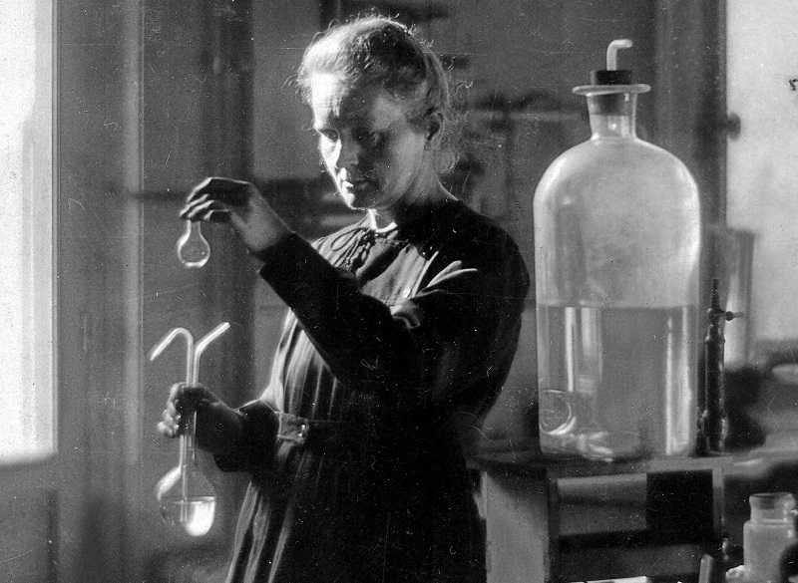





550 BC - Present
Chapter 32
PATTERNS OF CHANGE IN MEDICINE
patterns of change in medicine
Strand Two & Three: The History of the World
@MsDoorley

Slide 2




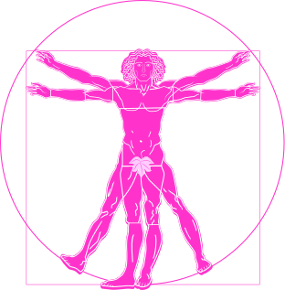

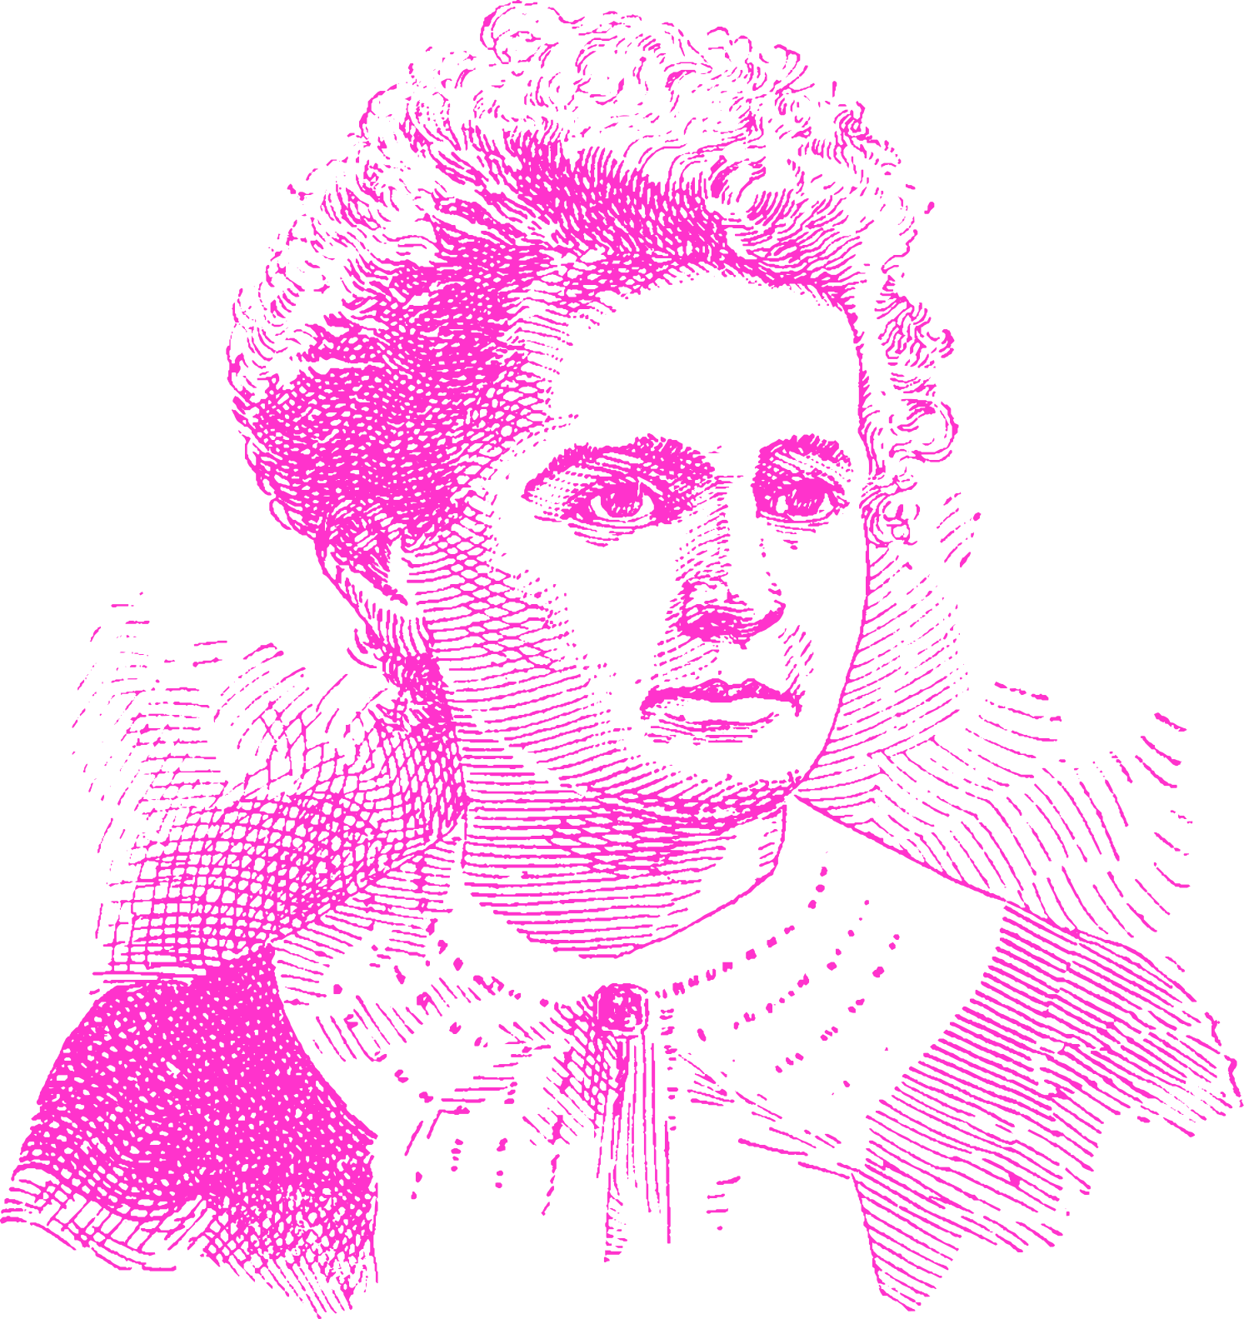
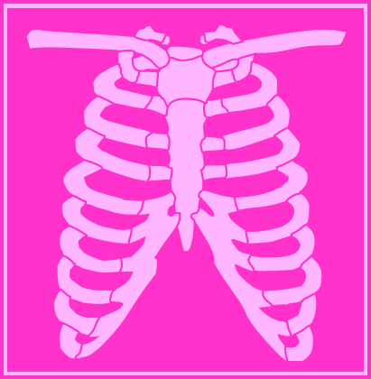

Chapter 32
PATTERNS OF CHANGE IN MEDICINE
Antonie van Leeuwenhoek invents the single-lens microscope
Robert Koch identifies the bacteria that causes cholera and tuberculosis.
Alexander Fleming discovers penicillin.
1500s
1670s
1796
1870s
1910s
1920s
1960s
Strand Two & Three: The History of the World
Chapter Thirty-Two: Patterns of Change in Medicine
@MsDoorley
Marie Curie develops the portable X-Ray to treat soldiers on the battlefields of WWI.
Gregory Goodwin Pincus and John Rock invent the contraceptive pill.
Renaissance doctors study anatomy
Edward Jenner invents the first vaccine for smallpox

Slide 3
Learning Outcomes
3.11 EXPLORE the contribution of technological developments and innovation to historical change
3.14 ILLUSTRATE patterns of change across different time periods in a chosen theme relating to life and society (such as, Crime and punishment; Food and drink; Work and leisure; Fashion and appearance or Health and medicine).
Strand Two & Three: The History of the World
Chapter Thirty-Two: Patterns of Change in Medicine
@MsDoorley

Slide 4
Introduction
A pattern of change in history is how changes occur in a particular area of history over a period of time. In this chapter, we will look at some patterns of change in health care and medicine throughout history, what the key changes were and how they came about. The study of the body and of how to keep people healthy and treat them when they are sick or injured has been a constant concern for humanity. At various points in our history, we have made great strides forward in understanding sickness and disease, finding ways to treat them and making health care more widely available.
Strand Two & Three: The History of the World
Chapter Thirty-Two: Patterns of Change in Medicine
@MsDoorley

Slide 5
550 BC - Present
Chapter 32
32.1: HEALTH AND MEDICINE IN ANCIENT TIMES
32.1: health and medicine in ancient times
Strand Two & Three: The History of the World
@MsDoorley

Slide 6
Medical Care in Ancient Greece and Rome
Throughout history, when humans in most cultures have been unable to explain something, we have tended to give responsibility for it to divine beings. This was the case in most cultures up until the modern era. In Ancient Greece, illness was seen as a punishment from the gods – a patient’s best chance of recovery was to make offerings at the nearest temple of Apollo (the god of healing) or of his son Asclepius.
Hippocrates of Kos (c. 460-370 BC), known as the ‘Father of Medicine’ was the first to write in detail about different diseases, illnesses and their symptoms. For the next two thousand years, his works became central to the practice of medicine. He was also the first to use symptoms to try to diagnose what a patient was suffering from. Hippocrates believed that sickness was due to an imbalance among the four humours (blood, black bile, yellow bile and phlegm) in the body. While this theory would later be proven false, Hippocrates was the first to understand that disease had natural causes, rather than divine.
Strand Two & Three: The History of the World
Chapter Thirty-Two: Patterns of Change in Medicine
@MsDoorley

Slide 7
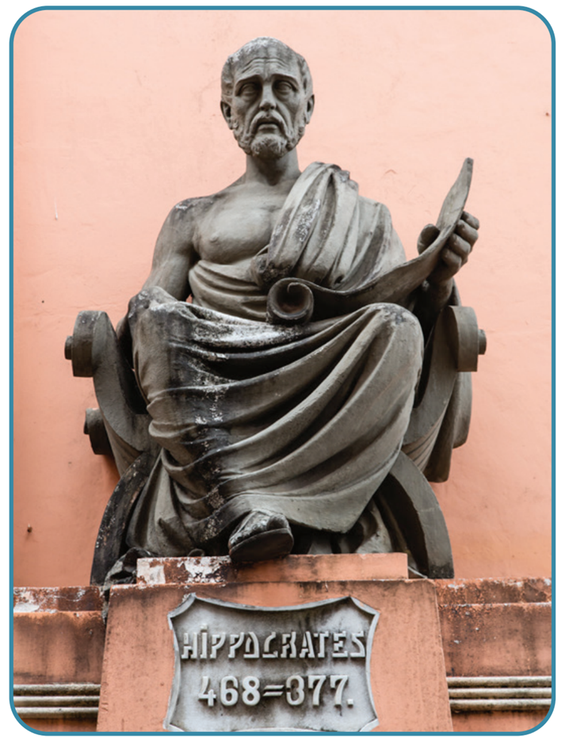
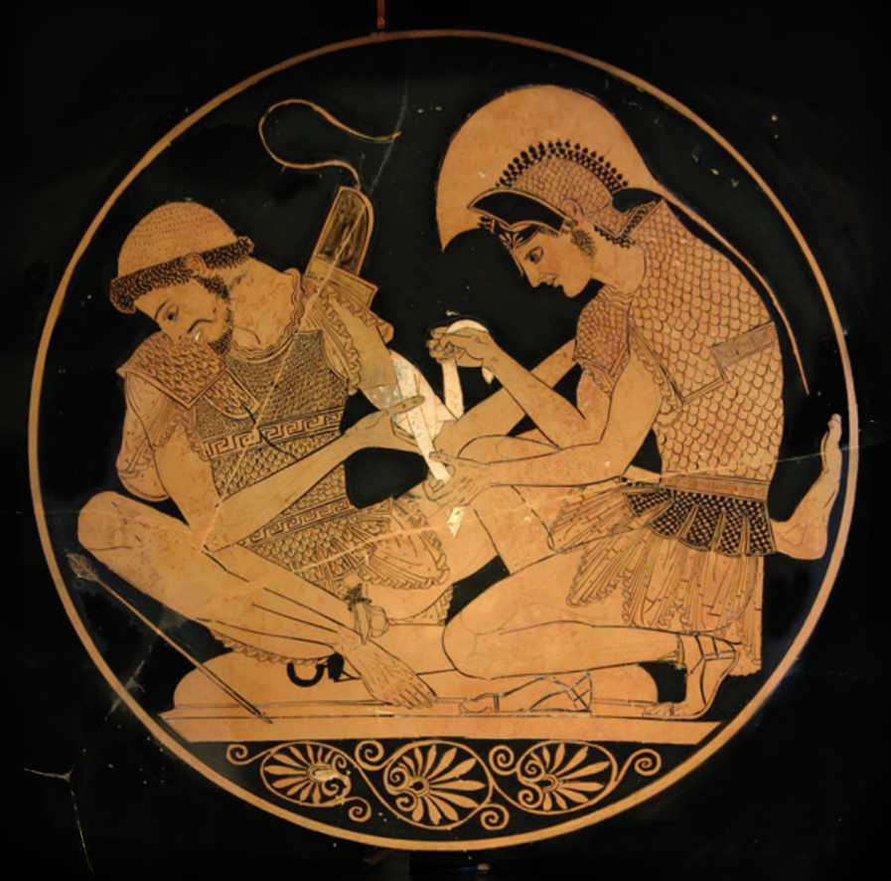
Strand Two & Three: The History of the World
Chapter Thirty-Two: Patterns of Change in Medicine
Diagram taken from Artefact, 2nd Edition by Eimear Jenkinson and Gregg O'Neill (educate.ie)
@MsDoorley

Slide 8
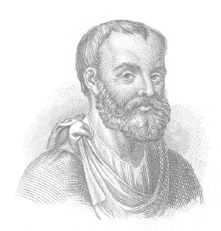
Galen of Pergamon
The work of Hippocrates was built upon by other physicians, especially Galen of Pergamon (AD 129 – 216) during the height of the Ancient Roman Empire’s power. Galen believed that in order to properly treat the body, knowledge of anatomy (the study of the structure of the human body) was essential. Due to a ban on human dissection, Galen experimented on and dissected animals which he thought had similar bodies to humans. However this led Galen to reach several false conclusions about how human organs worked thus leading to doctors treating people incorrectly for over a thousand years. There is evidence that Roman doctors preformed brain surgeries which would not be attempted again for nearly two thousand years.
Strand Two & Three: The History of the World
Chapter Thirty-Two: Patterns of Change in Medicine
@MsDoorley

Slide 9
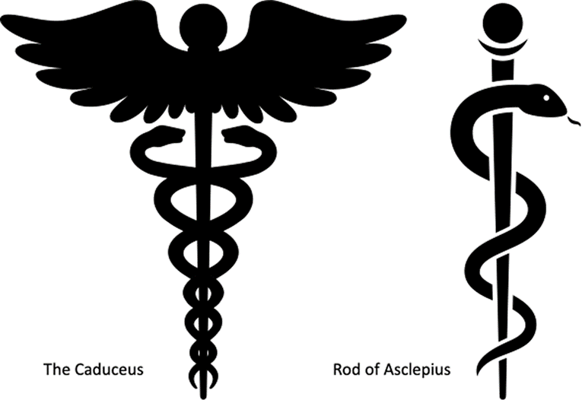
Public Health Care in the Ancient World
Access to health care was largely limited to those who could afford to pay the physicians’ fees. Physicians apprenticed with experienced doctors before setting up on their own. People who could not afford a doctor would go to healers, who sold herbal mixtures. Most of these did little to treat the underlying problem though some did provide pain relief. Temples to Asclepius operated as early medical centres where people could go to the priests for medical advice and treatment.
Strand Two & Three: The History of the World
Chapter Thirty-Two: Patterns of Change in Medicine
@MsDoorley

Slide 10
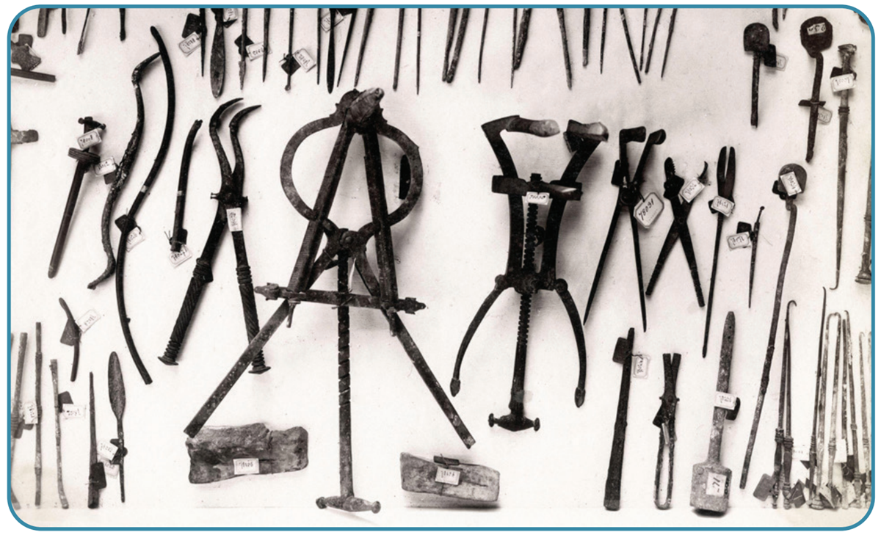
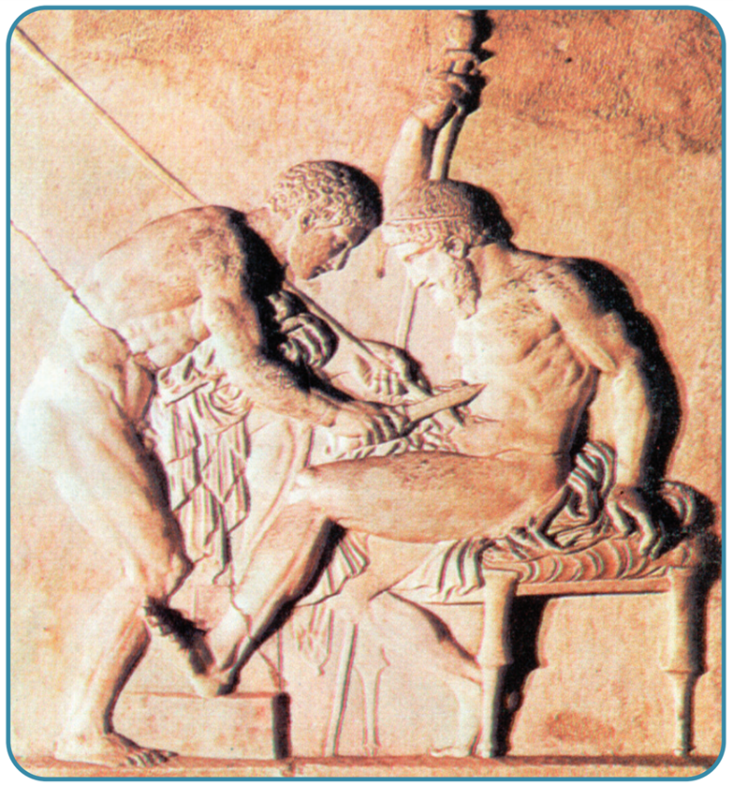
Strand Two & Three: The History of the World
Chapter Thirty-Two: Patterns of Change in Medicine
Diagram taken from Artefact, 2nd Edition by Eimear Jenkinson and Gregg O'Neill (educate.ie)
@MsDoorley

Slide 11
Questions Pg. 416 (Artefact 2nd Edition)
  How did people in the ancient world explain illness?
  Why is Hippocrates considered the ‘Father of Medicine’?
  How did Hippocrates explain illness?
  Who was Galen and what was his contribution to medical understanding?
  What was the problem with Galen’s approach to understanding human organs?
  How did people access health care in the ancient world?
Strand Two & Three: The History of the World
Chapter Thirty-Two: Patterns of Change in Medicine
@MsDoorley

Slide 12
550 BC - Present
Chapter 32
32.2: HEALTH AND MEDICINE IN THE MIDDLE AGES
32.2: health and medicine in the middle ages
Strand Two & Three: The History of the World
@MsDoorley

Slide 13
Medicine and Health in the Middle Ages
Illness and disease were incredibly common in the Middle Ages. People lived in cramped and unhygienic conditions and lacked basic sanitation. Fleas carried disease among people. Wounds, even minor ones, often became fatally infected. People who were poor and lacked a good diet were more prone to suffering from disease and less able to overcome infections. Diseases that were widespread included: typhoid, smallpox, puerperal fever, dysentery and influenza.
Strand Two & Three: The History of the World
Chapter Thirty-Two: Patterns of Change in Medicine
@MsDoorley

Slide 14
Sickness and Treatments
Medieval medicine was based on the theories of the Ancient Greeks, particularly surrounding the four humours (blood, black bile, yellow bile and phlegm) where it was thought that most sicknesses were due to an imbalance between the humours. Treatments for imbalances included:
  Bleeding: cutting the patient so that they bled.
  Cupping: placing heated metal cups on the skin to draw fluids to the surface
  Leeching: using leeches to draw blood or other fluids out of the body
  Amputation: cutting off a limb
Strand Two & Three: The History of the World
Chapter Thirty-Two: Patterns of Change in Medicine
@MsDoorley

Slide 15
The Black Death (Bubonic Plague)
The Black Death (bubonic plague) killed at least one-third of Europe’s population between 1347 and 1350. The plague was carried by fleas on rats that arrived via ships from the Black Sea area. Symptoms included oozing swellings all over the body, discoloured skin and the lungs filling with phlegm. It was extremely contagious, spreading via sneezing or spitting, or by touching dead bodies which were often left in the streets to be collected. Those infected had a 70-80% chance of dying within a week. Many believed the disease was caused by God’s anger at human sin. Others blamed groups of ‘outsiders’ such as Jews or Moors.
The death of so many people in such a short space of time changed Europe forever.
  The feudal system, especially serfdom, went into decline because many serfs left their manors to replace people in the towns. This meant that the peasants who remained on the manors could demand better treatment because there was now fewer of them left to do the work.
  Doctors had failed to find a cure for the bubonic plague and began to question their practices. This led to significant changes in medicine during the Renaissance.
Strand Two & Three: The History of the World
Chapter Thirty-Two: Patterns of Change in Medicine
@MsDoorley

Slide 16
Women's health
Male doctors in the ancient and medieval worlds made little to no attempt to understand differences between men's and women's bodies, especially in areas of reproductive health and childbirth. Doctors did not attend births; only midwives assisted, and they usually had little training beyond their experience of previous births. Women could suffer considerable blood loss during birth and if a problem arose (for example, if the baby was in the wrong position), little could be done for mother or child. In addition, women often contracted infections and died in the days after birth. Maternal childbirth fatalities have been estimated at about 2.5%, or one in 40 - a rate that remained constant from Ancient Rome until the eighteenth century.
Strand Two & Three: The History of the World
Chapter Thirty-Two: Patterns of Change in Medicine
@MsDoorley

Slide 17
Public Health Care in the Middle Ages
Life craftspeople in the medieval era, doctors' training was through apprenticing with more experienced doctors. There was no consistency to their medical knowledge beyond what they read in ancient manuscripts (where available) and what they were taught. Some countries had medical schools; the doctors who studied there usually served as family physicians to the rich and powerful. Monasteries often looked after the sick, functioning as the first hospitals in many countries.
Strand Two & Three: The History of the World
Chapter Thirty-Two: Patterns of Change in Medicine
@MsDoorley

Slide 18
Questions Pg. 417 (Artefact, 2nd Edition)
  Where did medieval medical knowledge come from?
  What were the common treatments for sickness in the Middle Ages?
  How did living conditions in the Middle Ages contribute to the spread of disease?
  Describe the medical treatment offered to women in the ancient and medieval worlds.
  ‘There was little progress in medical knowledge between the ancient and medieval times’. Do you agree or disagree with this statement? Explain your answer.
Strand Two & Three: The History of the World
Chapter Thirty-Two: Patterns of Change in Medicine
@MsDoorley

Slide 19
550 BC - Present
Chapter 32
32.3: HEALTH AND MEDICINE DURING THE RENAISSANCE
32.3: health and medicine during the renaissance
Strand Two & Three: The History of the World
@MsDoorley

Slide 20
Medical Advances during the Renaissance
By the Renaissance, two major barriers stood in the way of medical advances. Firstly, doctors were unwilling to challenge the ideas of Hippocrates, Galen and other ancient physicians. Secondly, the Catholic Church forbade the dissection of human corpses. People who wanted to study the body more closely, such as Leonardo da Vinci, had to conduct these dissections in secret. However, with the onset of the Reformation in the early sixteenth century, the Church's power was reduced and doctors in Protestant countries were unable to study the body more closely.
Strand Two & Three: The History of the World
Chapter Thirty-Two: Patterns of Change in Medicine
@MsDoorley

Slide 21
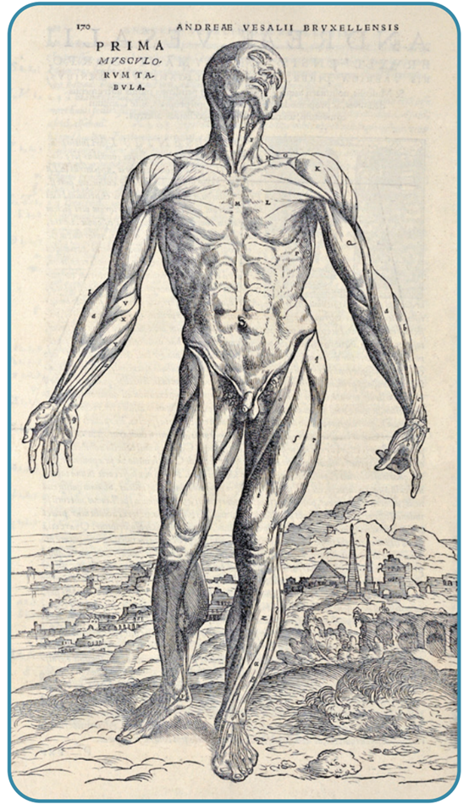
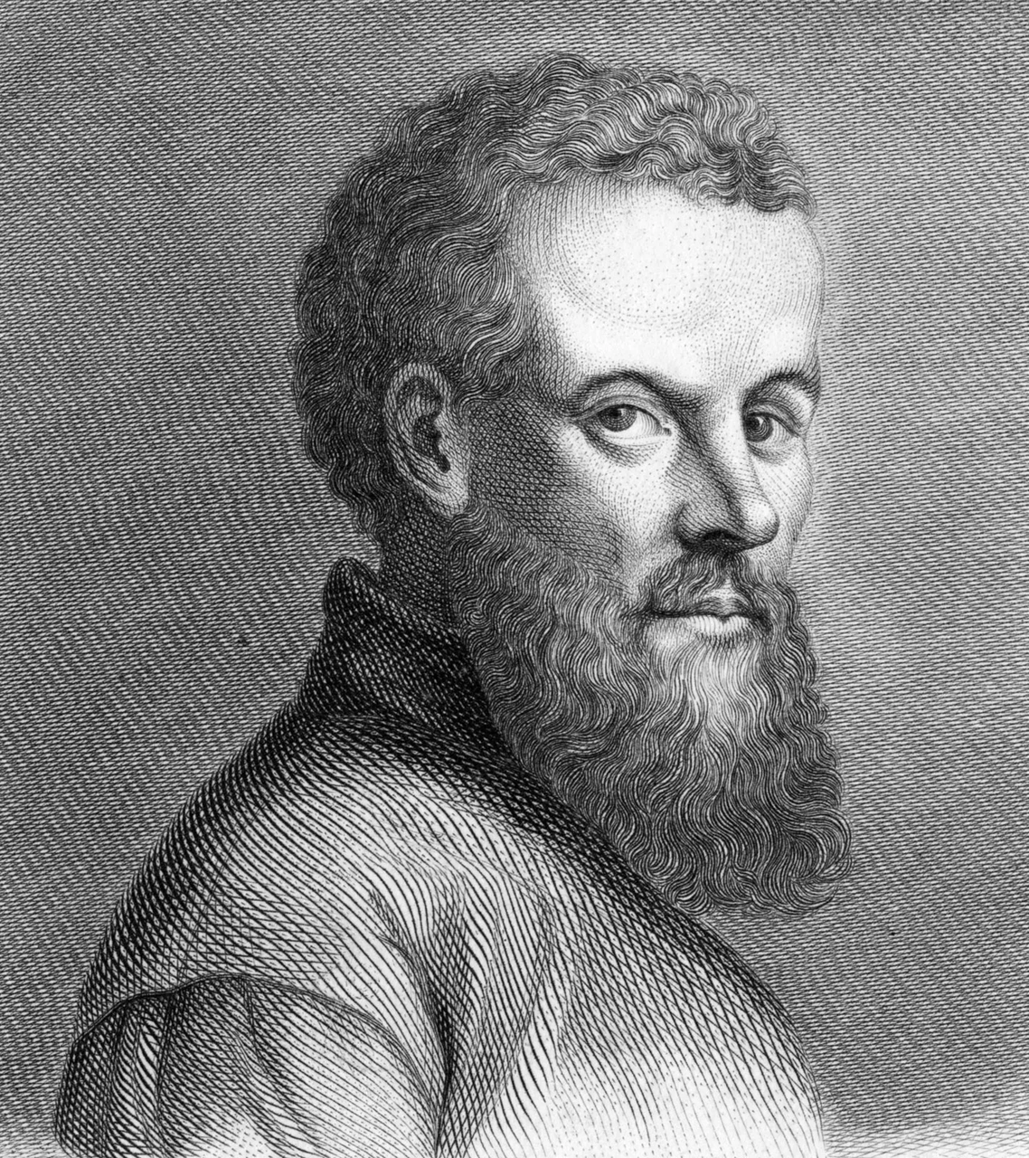
Strand Two & Three: The History of the World
Chapter Thirty-Two: Patterns of Change in Medicine
Diagram taken from Artefact, 2nd Edition by Eimear Jenkinson and Gregg O'Neill (educate.ie)
@MsDoorley

Slide 22
Medical Developments
With more freedom to study anatomy, doctors made significant advances in understanding how the body worked.
Andreas Vesalius began to investigate anatomy (the study of the human body), dissecting many human corpses and thus proving many of Galen's ideas incorrect. Vesalius wrote and published On the Structure of the Human Body, which contained detailed drawings of the body's internal organs, muscles and skeleton. Thanks to the Printing Press it was printed and widely read, allowing surgeons to operate more effectively on their patients.
William Harvey dissected living animals to see how blood circulated in their bodies. He showed that the heart pumped blood around the body and that the liver cleaned it, disproving Galen's belief that the liver constantly produced new blood that was absorbed in the body. These and many other discoveries helped advance medical understanding of the body significantly, particularly in surgery and the treatment of wounds.
Strand Two & Three: The History of the World
Chapter Thirty-Two: Patterns of Change in Medicine
@MsDoorley

Slide 23
Questions Pg 420 (Artefact, 2nd Edition)
  What barriers to advancing medical understanding existed before the Renaissance?
  What contribution to medicine did the following make: (a) Andreas Vesalius and (b) William Harvey?
Strand Two & Three: The History of the World
Chapter Thirty-Two: Patterns of Change in Medicine
@MsDoorley

Slide 24
550 BC - Present
Chapter 32
32.4: HEALTH AND MEDICINE IN INDUSTRIAL SOCIETY
32.4: health and medicine in industrial society
Strand Two & Three: The History of the World
@MsDoorley

Slide 25
The discovery of germs
For centuries, doctors believed that disease spread by miasmas (bad air) and that the spread of disease thus could not be controlled. However, in the 1670s, Antonie van Leeuwenhoek invented the first single-lens microscope. Using this, he saw tiny creatures that would later be known as germs or disease-causing microorganisms (for example, bacteria or fungi). Originally it was believed that germs were caused by disease. It was only much later that doctors realised that it was the other way around: germs spread disease. This discovery is called germ theory.
The most important figures in understanding the role of germs in disease were Louis Pasteur and Robert Koch in the 1870-80s. Pasteur was a French chemist who carried out experiments proving that milk, wine and beer went sour when exposed to microorganisms in the air. Koch, a German physician, applied Pasteur's findings to humans. He grew the germ that he believed caused a disease called anthrax and injected it into mice, making them sick. He also identified the specific bacteria that caused cholera and tuberculosis.
Once doctors understood how certain diseases were caused, they could begin to work on potential treatments.
Strand Two & Three: The History of the World
Chapter Thirty-Two: Patterns of Change in Medicine
@MsDoorley

Slide 26
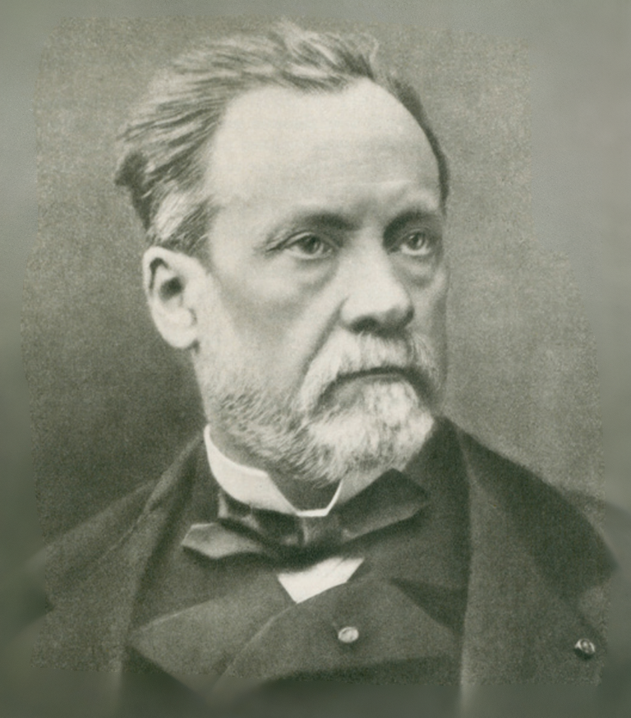
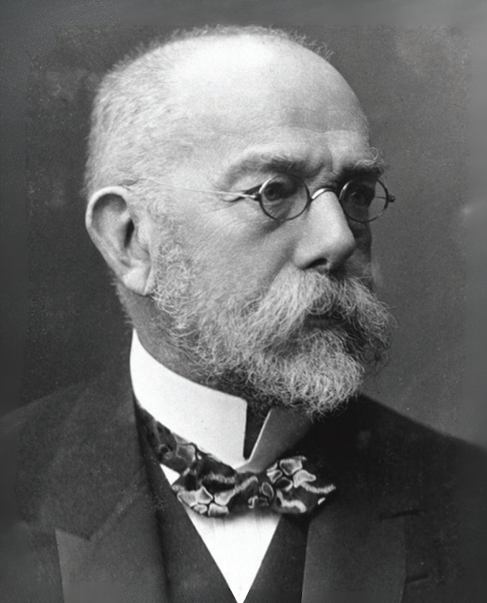
Strand Two & Three: The History of the World
Chapter Thirty-Two: Patterns of Change in Medicine
Diagram taken from Artefact, 2nd Edition by Eimear Jenkinson and Gregg O'Neill (educate.ie)
@MsDoorley

Slide 27
The invention of vaccines
Vaccines are medicines designed to prompt the immune system to develop the necessary antibodies to fight off a particular disease by exposing it to a non-dangerous version of the disease. The first vaccine was developed by Edward Jenner. In the 1770s, Jenner was treating people in rural England who were suffering from smallpox, a disease responsible for nearly 10% of all deaths in the eighteenth century. It was known that women who milked cows were significantly less likely to get the disease. Jenner believed that this was because they often contracted cowpox, a very mild form of smallpox. In 1796, he deliberately gave cowpox to an eight-year-old boy and then tried to infect him with smallpox. The body did not develop the disease and so became the first person to be vaccinated against smallpox. The disease has now been eradicated worldwide. Jenner's approach was later copied by Pasteur, who developed a vaccine for rabies. Since the late nineteenth century, vaccines have been created to fight against deadly, widespread diseases such as: Typhoid (1896); Tuberculosis (1921); Influenza (1930s); Polio (1955); MMR [measles (1963), mumps (1967) and rubella (1967)]; Covid-19 (2020).
Strand Two & Three: The History of the World
Chapter Thirty-Two: Patterns of Change in Medicine
@MsDoorley

Slide 28
Women's health in the nineteenth century
A better understanding of the body and of the links between germs and diseases significantly improved women's health care in this period. By the nineteenth century, surgery to remove cancerous tumours in the breasts and ovaries was common (even if the fatality rate was high). Doctors now regularly looked after women during childbirth and used ether and chloroform (painkillers in gas form) to ease their pain. The maternal mortality (death) rate finally began to fall when, in the 1880s, doctors connected germs on unwashed instruments and hands with the high mortality rates. Hygiene procedures such as handwashing and disinfection became standard.
Strand Two & Three: The History of the World
Chapter Thirty-Two: Patterns of Change in Medicine
@MsDoorley

Slide 29
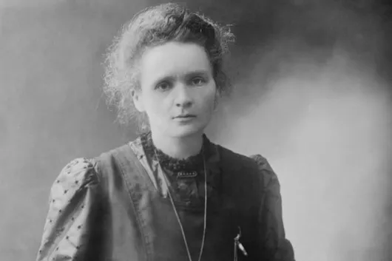
Marie Curie (1867-1934)
Marie Sklodowska was born in Poland and moved to Paris in 1891 to study Physics. She married Pierre Curie in 1895 and the two worked closely together on the study of radioactivity in metals. Their work earned them the Nobel Prize in Physics in 1903. After Pierre's death in 1906, Marie continued her work. She discovered two new chemical elements, polonium (named for her native Poland) and radium. She won Nobel Prize in Chemistry in 1911, making her the only woman to win two Nobel Prizes and the only person ever to win in two different scientific fields. During World War I, she invented and operated mobile x-ray units to help treat injured soldiers on the front lines. Her work would lead to the widespread use of x-rays in medicine and the use of radiation treatment for cancer.
Strand Two & Three: The History of the World
Chapter Thirty-Two: Patterns of Change in Medicine
Diagram taken from Artefact, 2nd Edition by Eimear Jenkinson and Gregg O'Neill (educate.ie)
@MsDoorley

Slide 30
Public Health Care in the Industrial Society
During the Industrial Revolution, cities became massively overcrowded. As the cases of diseases became more widely known - for example, that cholera spreads through bacteria in dirty water - laws were passed that required councils to provide clean water, improve sanitation and ensure the collection of rubbish.
The first largescale hospitals opened in big cities, often by charities. They provided some health care to those who could not afford to pay a doctor. During the Crimean War (1853-1856), Florence Nightingale had pioneered nursing innovations that focused on cleanliness on hospital wards. These were soon widely applied in hospitals. Germ theory led to the sterilisation of medical equipment during operations and dramatically increased the numbers of patients who survived surgery.
Strand Two & Three: The History of the World
Chapter Thirty-Two: Patterns of Change in Medicine
@MsDoorley

Slide 31
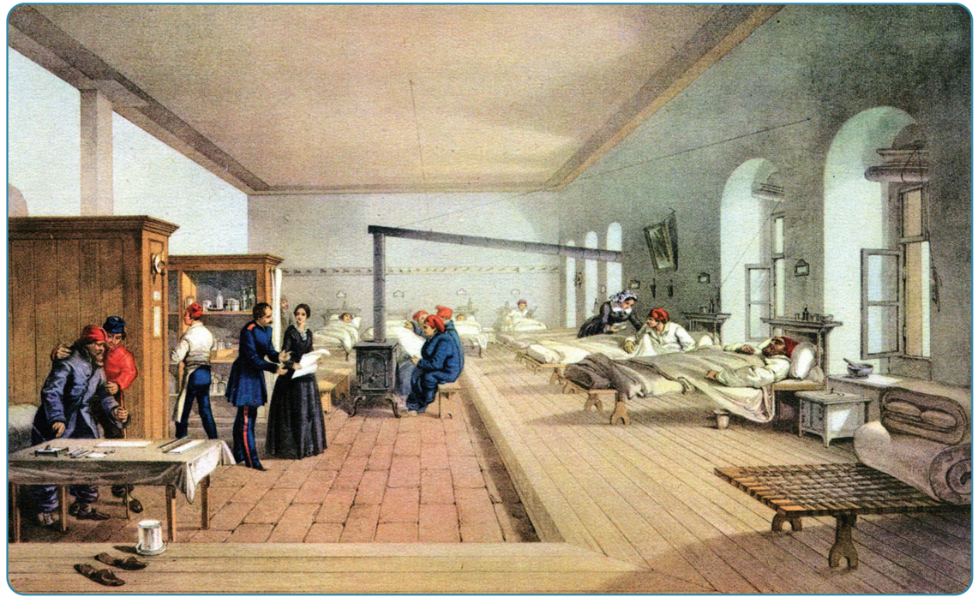
Strand Two & Three: The History of the World
Chapter Thirty-Two: Patterns of Change in Medicine
Diagram taken from Artefact, 2nd Edition by Eimear Jenkinson and Gregg O'Neill (educate.ie)
@MsDoorley

Slide 32
Questions Pg 420 (Artefact 2nd Edition)
3. What did Antonie van Leeuwenhoek discover and how did this help doctors better understand the causes of disease?
4. Explain how Edward Jenner developed the first vaccine for smallpox.
5. How do vaccines work? Give two examples.
6. How had medical care for women improve by the end of the nineteenth century?
7. During the nineteenth century, how did understanding the causes of disease lead to: (a) Improvement in public health and (b) Improvements in hospital care
Strand Two & Three: The History of the World
Chapter Thirty-Two: Patterns of Change in Medicine
@MsDoorley

Slide 33
550 BC - Present
Chapter 32
32.5: HEALTH AND MEDICINE IN THE TWENTIETH CENTURY
32.5: health and medicine in the twentieth century
Strand Two & Three: The History of the World
@MsDoorley

Slide 34
Medicine and Health in the 20th Century
Life expectancy increased dramatically in the twentieth century, as did quality of live. This is due to medical discoveries and inventions that have been able to control or cure many diseases and conditions. Medical understanding and the application of that knowledge developed more quickly in the twentieth century than at any other time in human history. Governments and companies spent vast sums of money on the development of medical treatments for a wide array of diseases, illnesses and conditions.
Strand Two & Three: The History of the World
Chapter Thirty-Two: Patterns of Change in Medicine
@MsDoorley

Slide 35
Advances in medication
Among the key developments in medical treatments in the twentieth century was the production of many new pharmaceutical drugs to treat illness and other ailments. These were manufactured medications developed through experimentation.
  1897 - Painkillers (Aspirin): easy to take painkillers allow people to cope with short- and long-term pain, which in earlier centuries had caused great distress and incapacity.
  1910 – Histamine (Antihistamines were discovered in 1937): A substance produced by the body when it suffers an immune reaction. Antihistamine drugs are now used to treat systems of mild allergies such as runny noses and watery eyes.
  1912 – The Discovery of Vitamins: micronutrients essential for good health. Doctors identified what levels of each vitamin are needed to avoid deficiency diseased such as scurvy (vitamin C) or rickets (vitamin D).
  1921 – Insulin: a hormone that breaks down sugar in the bloodstream. People with Type 1 diabetes cannot produce insulin naturally and must inject it instead.
  1928 – Penicillin: the first antibiotics, discovered by Alexander Fleming on bread mould. Penicillin is still used to treat many kinds of bacterial infection.
Strand Two & Three: The History of the World
Chapter Thirty-Two: Patterns of Change in Medicine
@MsDoorley

Slide 36
Advances in surgery
Surgery has undergone great advances since 1900. Operations can be carried out on many different parts of the body that had previously been inoperable. Among the many important surgical advances were:
  1853 – Endoscope: a thin fibre optic cable with a tiny camera on one end which allows doctors to view inside the body to investigate or to guide surgery.
  1914 – Portable X-Ray Machine: Marie Curie improved the x-ray discovered by the German engineer Wilhelm Conrad Röntgen in 1895, creating a portable x-ray machine that was first used in World War I to treat wounded soldiers on the frontlines.
  1953 - Coronary bypasses: improved blood supply to the heart through surgery. Since the 1960s, heart values can be replaced. In 1961 the pacemaker was developed; this maintains a regular heartbeat.
  1967 – CT Scans: a special x-ray machine that takes multiple images to produce a 3D picture of the inside of the body. It is often used after accidents, or to check for blood clots or unusual growths.
  1977 – MRI (magnetic resonance imaging): strong magnetic fields and radio waves are used to create detailed images of the organs and tissues. MRI scanning can detect areas of disease.
  Blood types: the four blood types (A, B, O and AB) were discovered before World War I. This made blood transfusions possible and blood donation schemes were set up.
  Laser surgery and keyhole surgery: these are less invasive surgical methods which lower the risk of infection and greatly reduce recovery time.
Strand Two & Three: The History of the World
Chapter Thirty-Two: Patterns of Change in Medicine
@MsDoorley

Slide 37
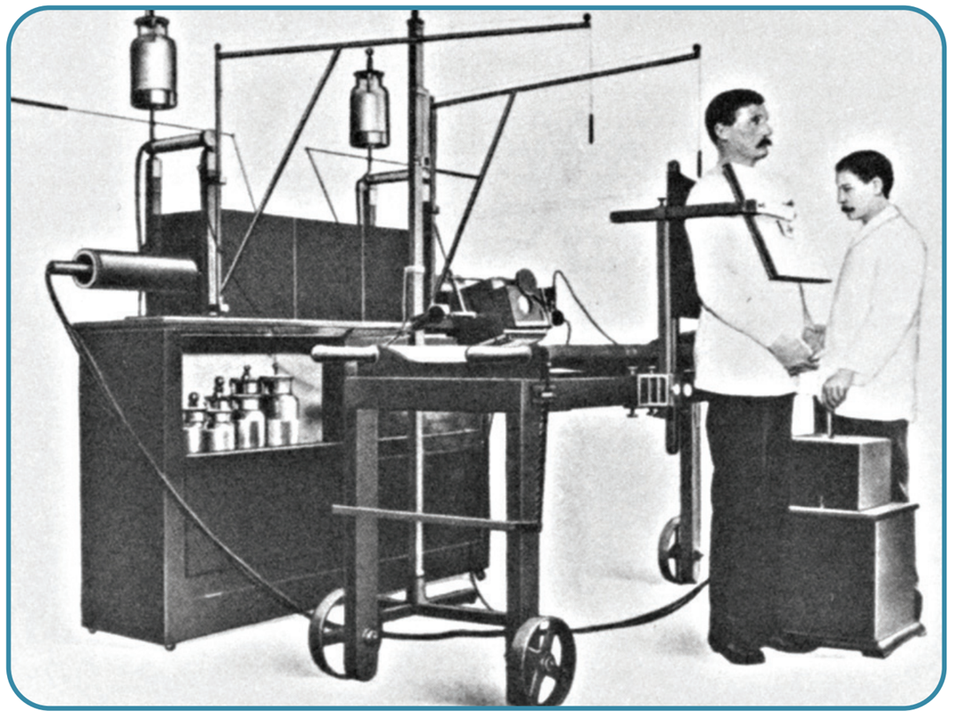
Advances in surgery
  Skin grafts and plastic surgery: both were known in earlier times but became very advanced in the twentieth century due to their usefulness in treating war injuries. After World War I, skin grafts (healthy skin taken from elsewhere on the patient) were used to help reconstruct faces that had suffered burns or shrapnel damage. During World War II, plastic surgery was likewise used to help repair faces.
  The most important area of surgical advances were the replacement of failing organs with healthy ones through organ transplantation. The first successful kidney transplant took place in 1954 while the first successful heart transplant took place in 1967. Other transplant surgeries include:
    Liver transplant (1963)
    Heart and lung transplants (1981)
    Brain tissue transplant (1987)
Strand Two & Three: The History of the World
Chapter Thirty-Two: Patterns of Change in Medicine
Diagram taken from Artefact, 2nd Edition by Eimear Jenkinson and Gregg O'Neill (educate.ie)
@MsDoorley

Slide 38
Women's health and reproductive medicine
Some of the twentieth century's biggest changes were seen in the area of reproductive medicine. Previously seen as largely the responsibility of midwives, significant advances were made in women's health after 1900, making pregnancy and childbirth safer for mother and child and allowing women more control over whether they became pregnant in the first place.
  Labour could be safely induced (begun artificially) and the use of epidurals (painkiller injections in the lower spine) eased the pain of childbirth.
  1956 – Ultrasound: High-frequency soundwaves are used to ‘see’ inside the body. Ultrasound is used to scan internal organs and tissues. Since the 1970s, they have also been used to monitor pregnancies harmlessly.
  1960 – Hormonal Contraception: the contraceptive pill for women was invented by Gregory Goodwin Pincus and John Rock in the 1960s which would rapidly transformed society as 'the Pill' contains hormones that temporarily prevent pregnancy (when taken correctly), allowing women control over their fertility. Women began to graduate from universities and advance their careers at much higher rates once pregnancies could be planned.
  1978 – In vitro fertilisation (IVF): a technique developed by Patrick Steptoe which can be used to help achieve a pregnancy when the natural method has been unsuccessful. Fertilisation takes place in a laboratory and the embryo is transferred to a woman’s uterus after several days. The first 'test-tube baby', Louise Brown, was born in 1978.
Strand Two & Three: The History of the World
Chapter Thirty-Two: Patterns of Change in Medicine
@MsDoorley

Slide 39
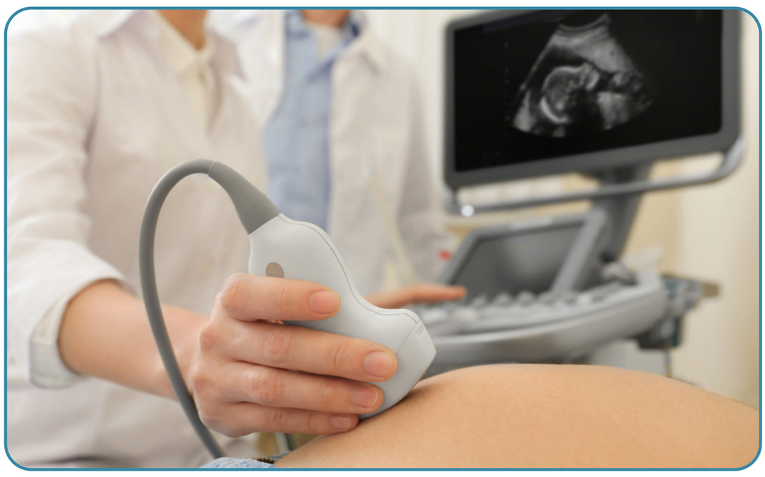

Strand Two & Three: The History of the World
Chapter Thirty-Two: Patterns of Change in Medicine
Diagram taken from Artefact, 2nd Edition by Eimear Jenkinson and Gregg O'Neill (educate.ie)
@MsDoorley

Slide 40
Public Health Care
In addition to the development of life-saving treatments for injury and disease, the twentieth century also saw a massive expansion of access to quality health care. Starting in Europe and accelerating in the years after World War II, governments created welfare states, or programmes where governments sought to greatly expand access to education, health care and other services, often making these free of charge. In health care, this has meant that more people than ever are able to access good quality care, prescription medicines and hospitals without having to worry about the cost.
Strand Two & Three: The History of the World
Chapter Thirty-Two: Patterns of Change in Medicine
@MsDoorley

Slide 41
Questions Pg 417 (Artefact 2nd Edition)
  What is penicillin and why was it an important advance in the treatment of illnesses?
  Describe the advances made in surgery in the twentieth century.
  Identify two advances in heart surgery in the twentieth century.
  Why was the invention of the contraceptive pill so important?
  What other developments have there been in reproductive medicine?
  How did access to health care improve during the twentieth century?
Strand Two & Three: The History of the World
Chapter Thirty-Two: Patterns of Change in Medicine
@MsDoorley

Slide 42
550 BC - Present
Chapter 32
32.6: SUMMARY
32.6: summary
Strand Two & Three: The History of the World
@MsDoorley

Slide 43
In this chapter, we have learned that...
  In the ancient world, illness was considered a divine punishment, to be treated with offerings to the gods. Two ancient scholars, Hippocrates and Galen, developed a more scientific approach to treating illness based on their observations of the body, experiments on animals and detailed study of different illnesses. Their work would dominate medical science until the Renaissance.
  During the Renaissance, the ideas of Hippocrates and Galen were largely disproven through the study of anatomy and the dissection of human corpses.
  In the eighteenth and nineteenth centuries, diseases were linked to germs and vaccines were developed that could prevent people from contracting certain illnesses.
  In the twentieth century, as scientific advances were made in other areas, medicine too advanced. There were huge success in the development of drugs to treat infections and illnesses while surgery was revolutionised, eventually leading to the transplantation of organs.
  Women’s reproductive health also saw huge advances: the contraceptive pill gave women more control over their fertility. IVF gave hope to couples who could not conceive naturally and procedures for assisting women in childbirth greatly improved.
  For most of human existence, access to medical care was limited to those who could afford to pay for it. This largely changed in the twentieth century, with many countries making many treatments available to all citizens as part of their welfare states. Although first world countries such as the USA are still behind European countries in this regard.
Strand Two & Three: The History of the World
Chapter Thirty-Two: Patterns of Change in Medicine
@MsDoorley

Slide 44
Reflecting on... Patterns of Change in Medicine
The desire to live as long and as well as possible has always been part of the human condition. In pursuing this, we have sought ways to control things like sickness and injury.
In the ancient world, this took the form of bargaining with divine beings. Later, we bled ourselves to restore balance between the ‘four humours’. In more modern times, we take care to eat well and exercise, visit the doctor regularly and take recommended medications. The expansion of medical knowledge and therefore care of the sick has been a singular success where humanity has steadily advanced, if at times slowly, over our existence.
Strand Two & Three: The History of the World
Chapter Thirty-Two: Patterns of Change in Medicine
@MsDoorley

Slide 45
Examination Questions
Strand Two & Three: The History of the World
Chapter Thirty-Two: Patterns of Change in Medicine
@MsDoorley

Slide 46
Project
Guidelines:
  Length: The depth of your project should reflect about 2-3 weeks of work.
  Sources: Use at least three different sources for your research. These can be books, scholarly articles, or reputable online resources.
  Citations: All information and images that are not your own should be properly cited.
  Mediums: You may choose to present your project in one of the following ways:
    Poster: Your poster should be informative and visually engaging.
    Minecraft or Lego Model: If choosing this option, please also include a brief report explaining your model.
    Painting/Drawing: Your artwork should be accompanied by a description.
    Recycled Materials: Create your model using recycled materials and provide an explanation of your creative process.
Assessment:
Your projects will be assessed based on:
  Research and Content
  Creativity and Presentation
  Understanding of Context
  Adherence to Guidelines
Strand Two & Three: The History of the World
Chapter Thirty-Two: Patterns of Change in Medicine
@MsDoorley

Slide 47
Project
Historical Sites
Historical Figures
Johns Hopkins Hospital, Baltimore, Maryland, USA
Alexander Fleming Laboratory, St. Mary's Hospital, London
Mayo Clinic, Rochester, Minnesota, USA
Banting House, London, Ontario, Canada
Asclepius Sanctuary, Epidaurus, Greece
Metrodora
Mary Seacole
Florence Nightingale
Marie Curie
Rosalind Franklin
Tu Youyou
Françoise Barré-Sinoussi
Strand Two & Three: The History of the World
Chapter Thirty-Two: Patterns of Change in Medicine
@MsDoorley

